Slide 1
Week 22

Slide 2
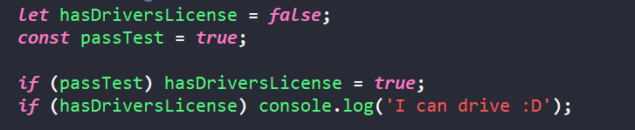
Strict mode
This mode helps us write code that is more safe
When you make a mistake with strict mode, browser will let you know (this doesn’t apply to complicated logic).
Try this code without and with Strict mode
Strict mode activation – just write at the top of the file: ‘use strict’

Slide 3
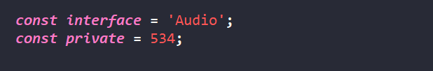
Strict mode
It will stop you from using very important words in wrong way.
Such examples are:
Private
Interface

Slide 4

Functions
They are the most important part of JavaScript language
We will use them a lot
And here we will open up the topic with basics
You will see it is different than those of C++ and C#
Whatever is inside { } is called a function body, and will be executed when you call the function

Slide 5

Functions
Function declaration:
Function calling / running / invoking (or executing):
As you can see, we can call function as many times as we want
We will get the result 3 times in this case

Slide 6
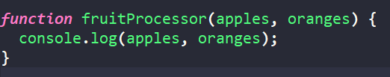

Functions
In previous example function was just executing piece of code
However, function can receive data and return it back as well
We give the function data (function can receive data) by using parameters:
We call the function and we provide those parameters:

Slide 7
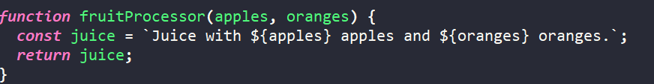
Functions
We define function that:
Has 2 input parameters
will return some value
We call the function like this:
This way we store the value in the variable, so we can use it later

Slide 8



Function Declarations vs Expressions
Declaration is the classical way of definition and execution:
However, expression way of declaration acts like defining a variable:
Function using Declaration can be called before definition. Expression cannot be used before defining it.

Slide 9

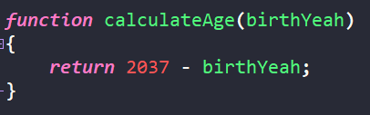
Arrow functions
Arrow functions look a bit strange, and we need to get used to them.
You could previously see something similar to arrow function in C# Those were lambda expressions (when we were learning about reading from database)
So this is it:
It is the same like:

Slide 10
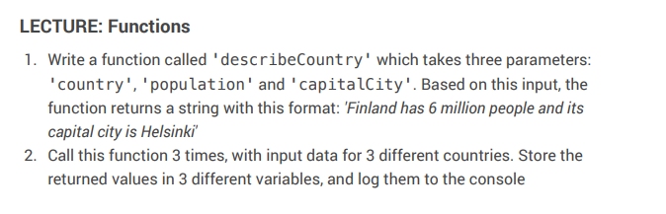
Code Challenge

Slide 11
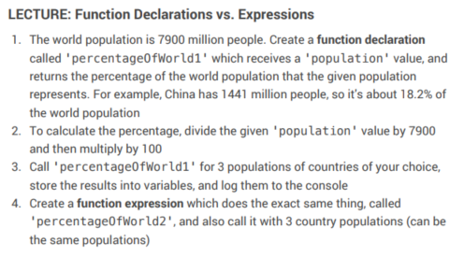
Homework

